Slide 1
Comprehensive Weather Data Analysis
Key Insights and Recommendations For Bangladesh Climate

Slide 2
Project Overview:
Objective: To analyze weather data and uncover patterns in temperature, wind speed, humidity, pressure, and rainfall.
Goal: Provide actionable insights for agriculture, urban planning, and resource management.

Slide 3
Data Cleansing Process
Steps Taken:
Handled missing values (mean/median filling)
Detected and treated outliers (temperature, wind speed)
Standardized data formats for consistency
Outcome: Cleaned, reliable dataset for accurate analysis

Slide 4
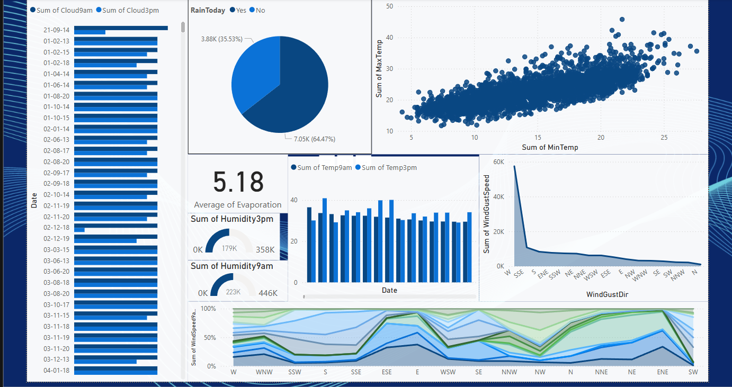
Title and Content Layout with Chart

Slide 5
Exploratory Data Analysis (EDA) – Wind Speed
Findings: Morning wind speeds are typically higher than afternoon.
Insight: Can impact daily activities and renewable energy generation.
Visualization: Line chart showing wind speed trends over time

Slide 6
EDA – Humidity Analysis
Findings: Humidity peaks in the morning and drops by afternoon.
Insight: Important for crop planning and outdoor conditions.
Visualization: Bar chart comparing morning vs. afternoon humidity

Slide 7
EDA – Temperature and Pressure Analysis
Temperature Insight: Afternoon temperatures are highest, seasonal fluctuations observed.
Pressure Insight: Stable morning pressure, minor afternoon fluctuations.
Visualization: Line graphs for temperature and pressure over time

Slide 8
Rainfall Patterns
Findings: Concentrated in specific months, indicating a monsoon season.
Insight: Useful for agriculture and water resource planning.
Visualization: Monthly rainfall bar chart

Slide 9
Key Insights and Conclusion
Summary:
Afternoon temperatures peak at 3 PM.
Morning humidity and stable pressure trends noted.
Rainfall is seasonal, beneficial for agriculture planning.
Recommendations: Use these insights for climate-resilient planning in agriculture, urban development, and resource allocation.

